Slide 1
Compiler Construction

Slide 2
Input buffering
The lexical analyzer has to recognize the longest possible string.
  Ex: identifier initial -- i in ini init initi initia initial
What is the end of a token? Is there any character which marks the end of a token?
  It is normally not defined.
  If the number of characters in a token is fixed, in that case no problem: Ex: +
  The end of an identifier : the characters cannot be in an identifier can mark the end of token.
  We may need a lookahead

Slide 3
Input buffering (contd.)
The lexical analyzer needs to look ahead several characters beyond the lexeme for a pattern before a match can be announced.
For instance, we cannot be sure we have seen the end of an identifier until we see a character that is not a letter or digit, and therefore is not part of the lexeme for id.
In C, single-character operators like =, >, or < could also be the beginning of a two-character operator like ==, >=or <=.
Thus, we shall introduce a two-buffer scheme that handles large lookaheads safely

Slide 4
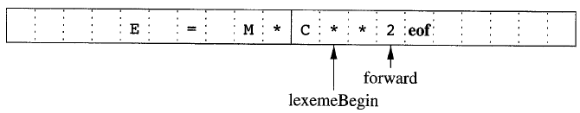
Buffer Pairs
The buffer is divided into two N-character halves
N = Number of characters on one disk block
One system command read N characters
Fewer than N character => eof

Slide 5
Buffer Pairs (contd.)
Uses two pointers: 1) LexemeBegin, and 2) Forward
The string of characters between the two pointers is the current lexeme.
Initially, both pointers point to the first character of the next lexeme to be found.
Pointer LexemeBegin marks the beginning of the current lexeme, and pointer forward scans ahead until a pattern match is found.
Once the lexeme is determined, forward is set to the character at its right end.

Slide 6
Buffer Pairs (contd.)
In above Fig. we see forward has passed the end of the next lexeme, ** (the Fortran exponential operator), and must be retracted to one position to its left.
So, after lexeme is processed, both pointers are set to the character immediately past the lexeme.
With this scheme, comments and white spaces can be treated as patterns that yield no token.

Slide 7
Buffer Pairs (contd.)
Advancing forward requires that we first test whether we have reached the end of one of the buffers, and if so, we must reload the other buffer from the input, and move forward to the beginning of the newly loaded buffer.

Slide 8
Buffer Pairs (contd.)
Code to advance forward pointer
if forward at the end of first half then begin
  reload second half ;
forward : = forward + 1;
end
else if forward at end of second half then begin
reload first half ;
move forward to beginning of first half
end
else forward : = forward + 1;

Slide 9
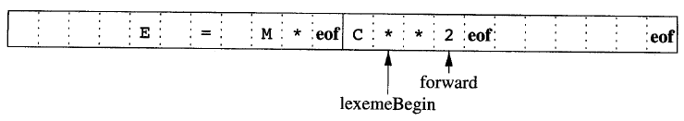
Sentinels
If we use the scheme of Buffer Pairs as described, for each character read, we make two tests: one for the end of the buffer, and one to determine what character is read.
We can reduce the two tests to one if we extend each buffer half to hold a sentinel character at the end.
The sentinel is a special character that cannot be part of the source program, and a natural choice is the character eof.
Any eof that appears other than at the end of a buffer means that the input is at an end.

Slide 10
Sentinels (contd.)
Code to advance forward pointer
forward : = forward + 1 ;
if forward ↑ = eof then begin
if forward at end of first half then begin
reload second half ;
forward : = forward + 1
end
else if forward at end of second half then begin
reload first half ;
move forward to beginning of first half
end
else / * eof within buffer signifying end of input * /
terminate lexical analysis
end

